Slide 1

A million eyes on your video experience

Slide 2


Slide 3



Overview
Milyoni is building a portfolio of services for managing the relationship between entertainment producers and their audiences.
The components of the ALM solution suite are focused at enhancing the social experience and maximizing data generation.
#SocialVideo SDK
VideoCards
Audience Life Cycle Management
Notes:
These services can all work together to provide a complete ALM solution suite, or can be accessed independently to custom match client needs

Slide 4
Key Principles
HIGH QUALITY
EASE OF USE
PRIVACY & SECURITY
RAPID DEPLOYMENT
MARKET LEADERSHIP
VALUE ADDED
Notes:
• High Quality – Milyoni services must maintain a market posi8on as the highest quality services in our vertical
• Rapid Deployment – Careful attention must be focused on tradeoffs between added quality provided through customization and deployment speed
• Ease of Use – Audience facing services must be simple to use without any help or assistance
• Market Leadership – Milyoni must establish and maintain itself as the market leader in ALM and supporting services
• Privacy/Security – Milyoni must establish the highest standards for privacy and data security amongst social media conduits
• Value Added – Milyoni will work to provide optimum integration with readily available services

Slide 5
Primary Objectives
f
6
9
7
Acquire new users and increase audience reach
Engage consumers more deeply by offering a highly interactive social experience
Increase awareness and distribution of your content
Establish a cohesive data-driven solution designed to maximize customer lifetime value

Slide 6
#SocialVideo

Slide 7







#SocialVideo is the core
We address each digital community with unique services to amplify our reach
Primary
Community
#SocialVideo / SDK
Engagement
#SocialVideo
Core destination site for brand
VideoCards
Subscriber
Community
Mobile Distribution
Interactive cards that live outside the core
Shares + Video Ads
Extended
Community
Awareness
Outbound and shareable expressions
and/or integrated ad networks

Slide 8
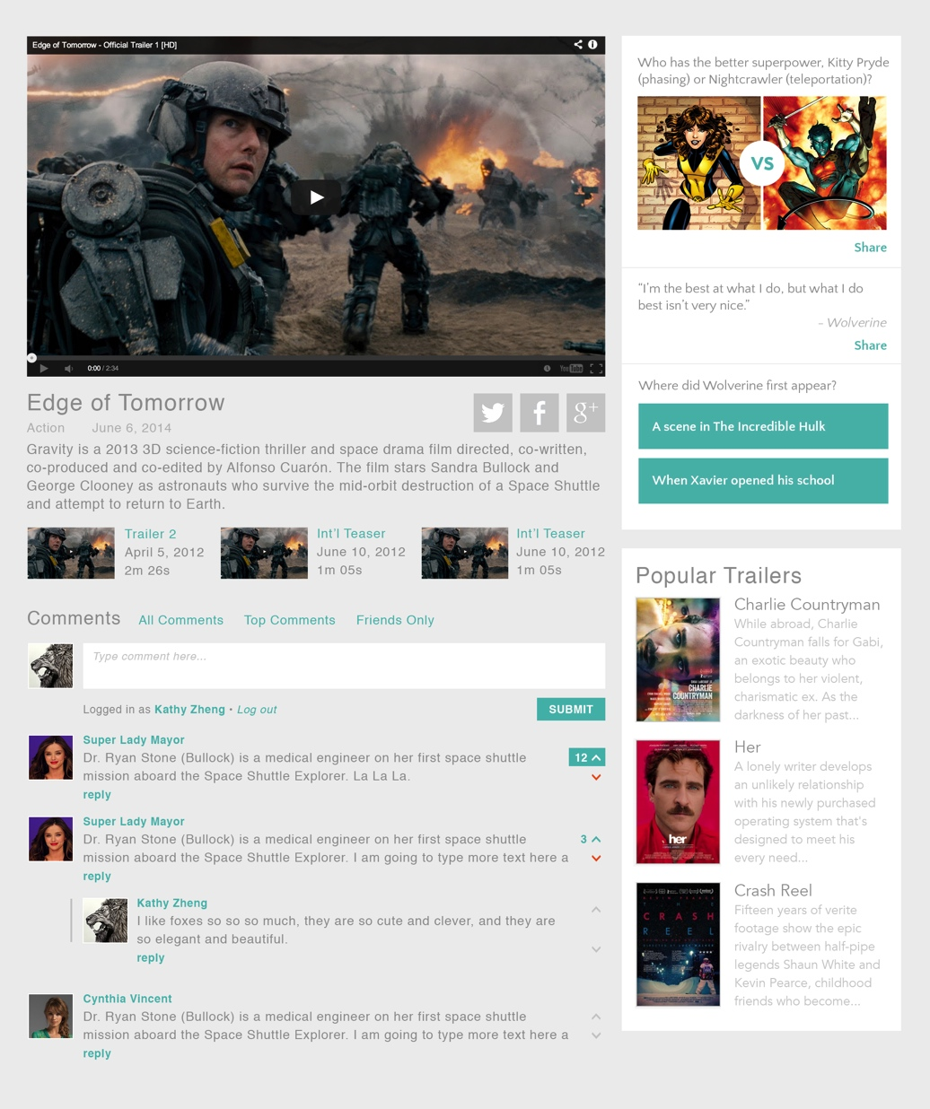
#SocialVideo
enhances viewing experience
via an array of features
8
VIDEO CONTENT
PERSONALIZATION
#SocialVideo
Experience
CHAT
ENGAGEMENTS
SHARING
Notes:
Thimbl.com – Milyoni’s current web application is Thimbl.com.
The application employs Milyoni’s APIs, SDK, and Video Content Management.
The initial implementation is based on Feature Film Previews.
Our SDK version enables clients to construct their own flexible site

Slide 9

9
Stacy loved the first
season of The Bridge
She constantly tries to convert all her friends, has predictions on what’s going to happen next and can’t wait to see more of Matthew Lillard.

Slide 10

10
#SocialVideo puts her knowledge to the test with trivia, gives her the best quotes to pull out at parties and memorable clips to share with her online friends.

Slide 11
#SocialVideo vs Standard Video
250%
200%
150%
100%
50%
0%
196%
98%
22.2%
3.8%
1.9%
0.5%
Expressions
/ Viewers
Interactions
& Viewers
Tweets
& Followers
FB mentions
& Likes
Yahoo mentions
& Likes
Youtube
Views & Likes

Slide 12
VideoCards

Slide 13
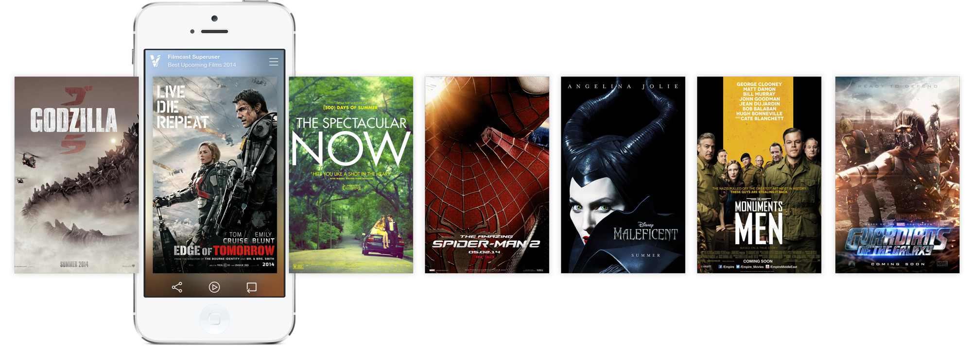

Slide 14
VideoCards - Features
Mobile-first design with swipe and
flip features
Leverage YouTube for
rapid deployment and
content sourcing
Create and publish a
set of 5 cards
Linkable to iTunes,
Amazon, Fandango, or
any other retailers
Generate additional
revenue from brand
sponsors
Distribute via Facebook
and Twitter accounts

Slide 15
Big Data Generation
Big Data &
Social Profiles
User Data extracted
from ARM communities
Hundreds of user attributes
Anonymous
Demographic
Social
Affinity
Behavioral

Slide 16
Audience Relationship Management

Slide 17


Audience Relationship Management (ARM)
Enhancing audience interaction with media
Gaining greater insights to the audience in order to optimize offers and future interactions
Notes:
The two primary focuses of ALM are:
enhancing audience interaction with media (eg. chaIlenge or engaging around the media), and
gaining greater insights to the audience in order to optimize offers and future interactions

Slide 18

The Complete ARM Solution
Video Catalog
#SocialVideo / SDK
VideoCards / Offers
Channels
Social
Email
Mobile
Ad Networks
Offer Management
iGoDigital
ExactTarget
Content
Commerce
Engagement
Invitations
Customer Intelligence
Engine
Marketing Cloud
Radian6
Social Listening

Slide 19
ARM Effects
Harvesting appropriate user profile data maximizes the quality of the audience experience and provides value-add to the client
Big Data &
Social Profiles
Analytics
1/22
1/15
1/8
1/1
Anonymous
Demographic
Social / Affinity
Behavioral
0 20 40 60 80
Facebook
Pinterest
YouTube
Twitter
Notes:
Value-Added
• Gains valuable insights into consumer behavior
• Optimizes & targets offers and future interactions
• Provides re-marketing potential

Slide 20
Greater Lifetime Value & Lower Costs
$$
PPV
Subscriptions
New revenue streams
Audience
lifetime revenue
Audience acquisition cost
2014 2015 2016 2017

Slide 21
Implementation Strategy
30 days
Launch video cards in 30 days or less
60 days
Launch #SocialVideo platform in 60 days or less
90 days
Launch ALM solution with priority offers in 90 days or less

